Slide 1


Assembling and Automating Efficient Monte Carlo Simulations for Latent Variable Models in R
https://github.com/horourke/csp24
Holly P. O’Rourke
Arizona State University

Slide 2
Process & Rationale for Tutorial
Code developed over the course of two projects
Language conversion
Converting old Mplus/SAS simulation code to R
MplusAutomation
Converting old SAS data generation code to R
Data gen in base R, data gen with MplusAutomation
Evolution of the R code
Assembling code to ensure it worked for a single dataset (replication)
Automating code to iterate over multiple conditions/replications
Editing code to be efficient

Slide 3
Why MplusAutomation in R?
Path model sims can also be created with base R, Lavaan, other packages
Why R?
Free
Lots of packages = improved ease of use
Why Mplus?
Familiarity, extensive documentation, flexibility
R packages can do a lot of things that Mplus can, but not always easily or efficiently
Why generate data with MplusAutomation instead of in base R?
For this ex: Data generation & analysis scripts are very similar in Mplus = less work to set up the scripts
(Sometimes it may make more sense to generate data in base R depending on model, ex. LCS models)
Hallquist, M. N. & Wiley, J. F. (2018). MplusAutomation: An R Package for Facilitating Large-Scale Latent Variable
Analyses in Mplus. Structural Equation Modeling, 25, 621-638. doi: 10.1080/10705511.2017.1402334.

Slide 4
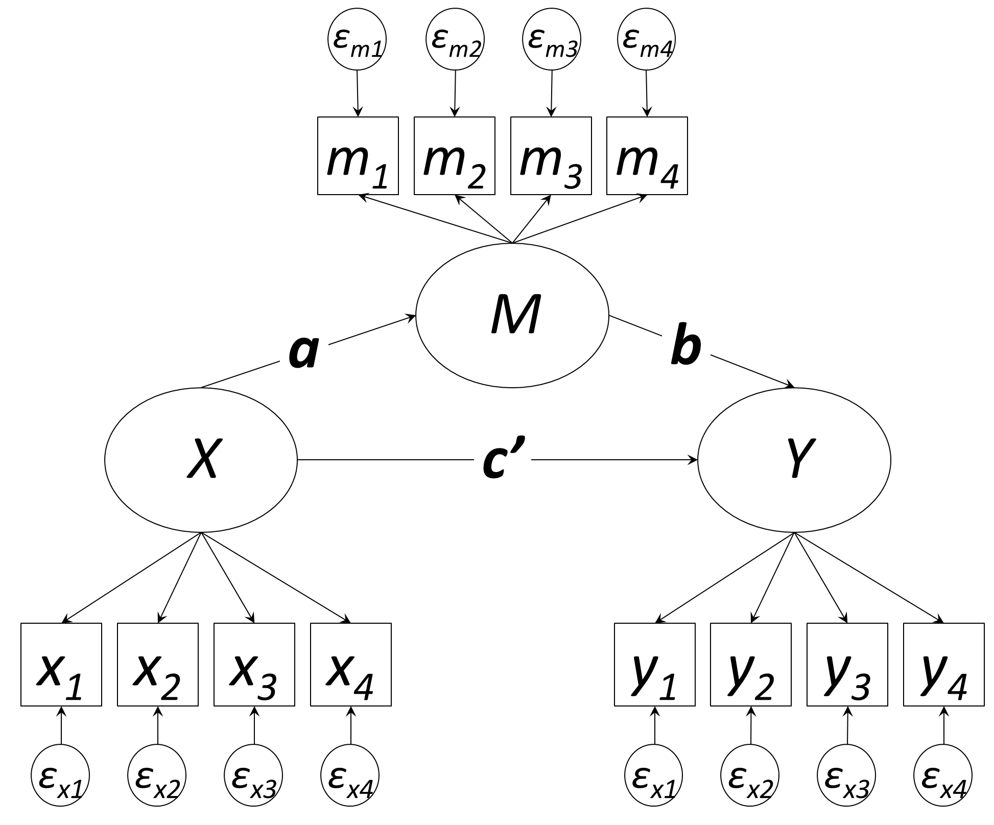
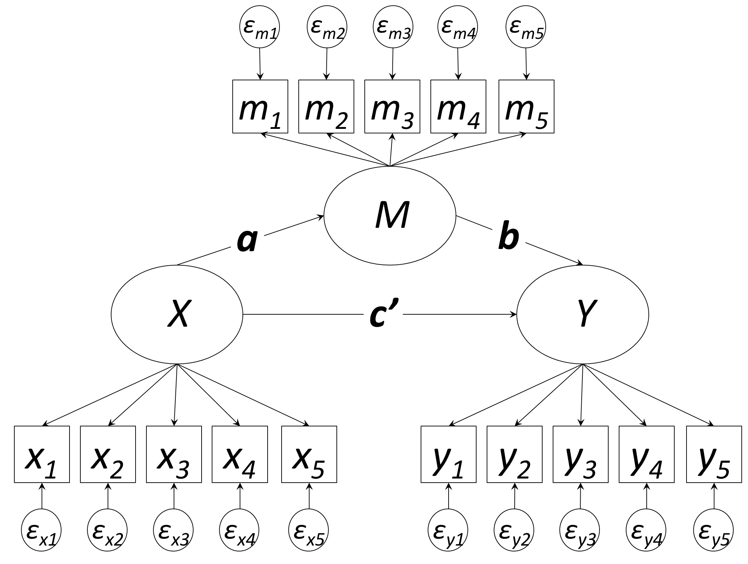
Example Simulation Study: Intro
Study rationale
Compare mediated effects (ab) from two latent variable mediation models with varying # of indicators

Slide 5
Example Simulation Study: Design
2 factors
Number of indicators per latent variable (2 levels)
4 indicators, 5 indicators
Sample size (2 levels)
100, 500
2 x 2 = 4 total conditions
500 replications x 4 conditions = 2000 datasets to be analyzed
Simulation study outcomes: Relative bias, efficiency, power
Model output needed: Path estimates, standard errors, p values

Slide 6
Tutorial Outline
Using MplusAutomation & dplyr, create & run scripts for:
Data generation
Replication-level model estimation
Save model estimates by condition
Merge estimates into a single study-level file
We won’t cover:
Reading in study-level estimates
Creating sim study outcomes
Analyzing sim study outcomes
Example code on GitHub coming soon!

Slide 7
Data Generation
Create master directory & condition sub-directories
Write data generation scripts
Simulate data into condition folders
Move data gen scripts out of sub-directories

Slide 8
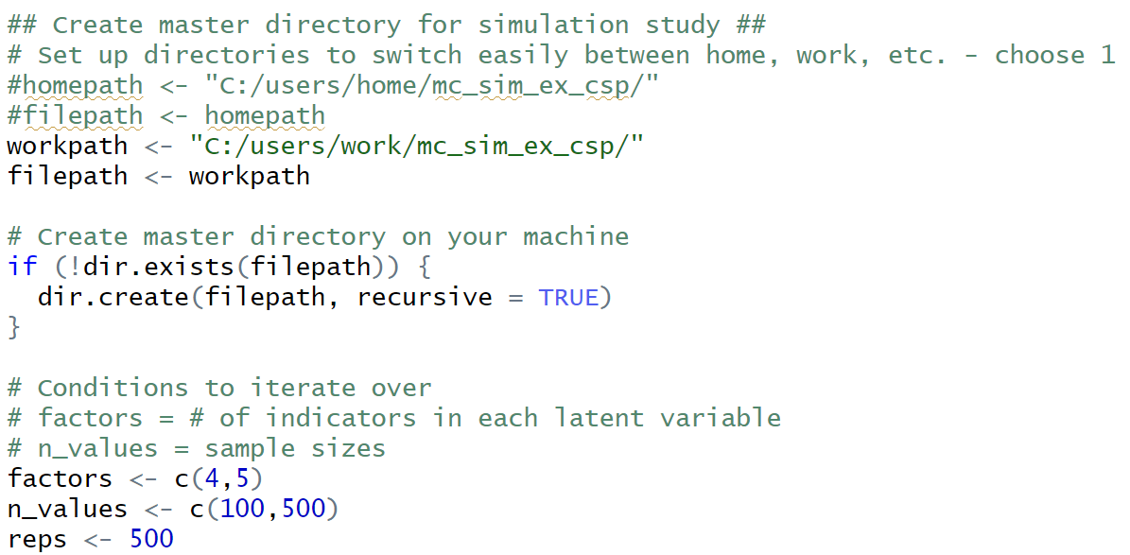
Creating Master Directory
Create master directory (folder) & sub-directories for each condition: dir.exists() & dir.create()
Make sure you have permission to write & edit your directories!
Notes:
Recursive = TRUE means it creates all elements of the path

Slide 9
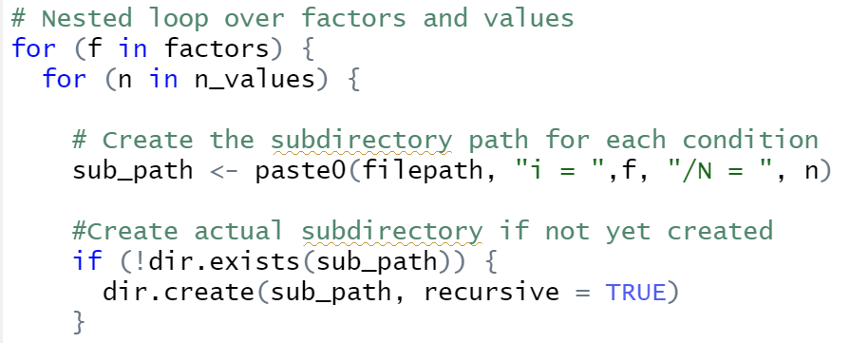
Creating Sub-Directory by Condition
Create master directory (folder) & sub-directories for each condition: dir.exists() & dir.create()
Make sure you have permission to write & edit your directories!

Slide 10
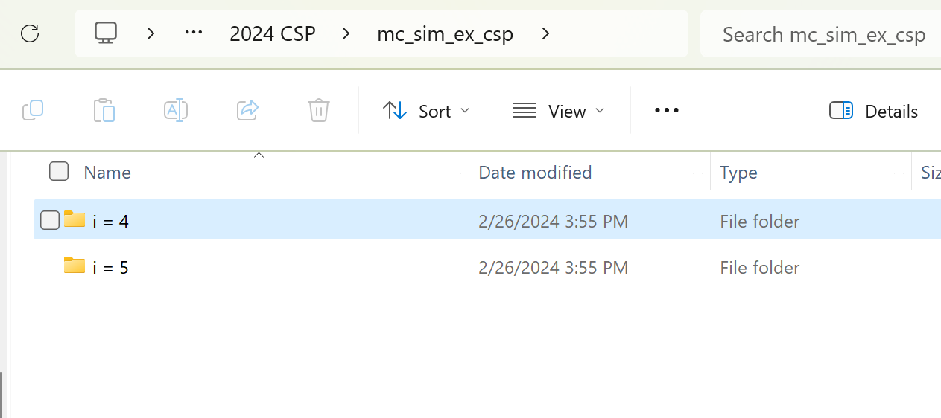
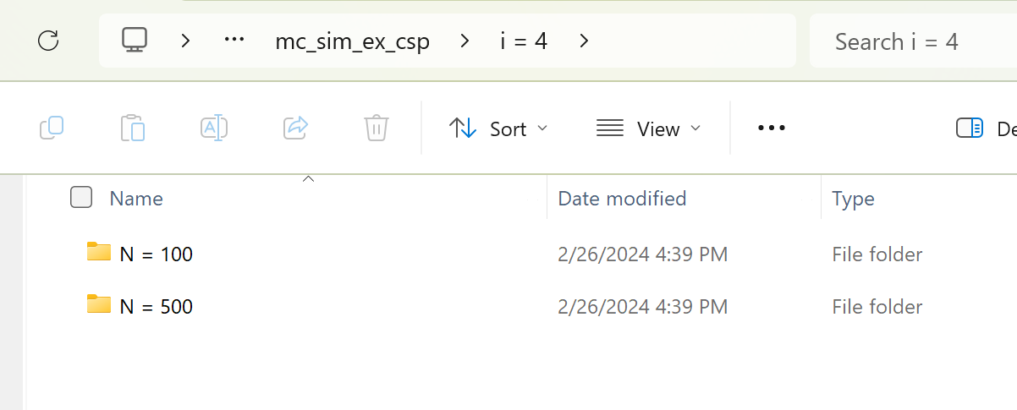
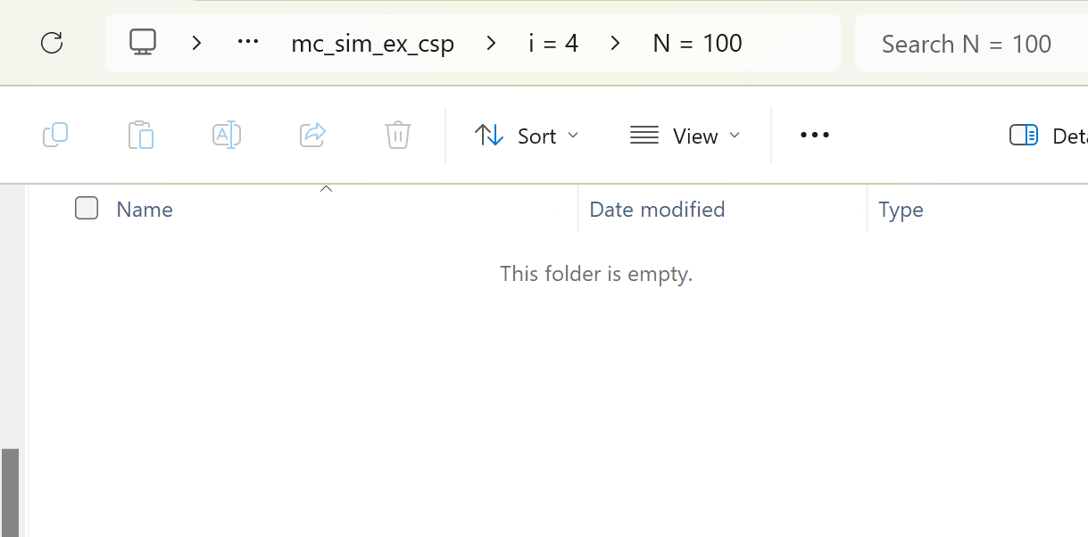
Directory Organization

Slide 11
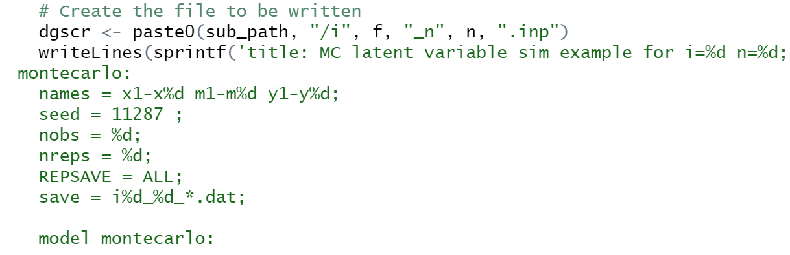
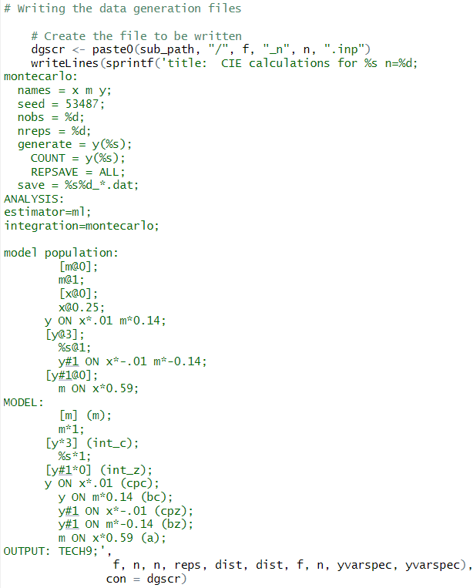
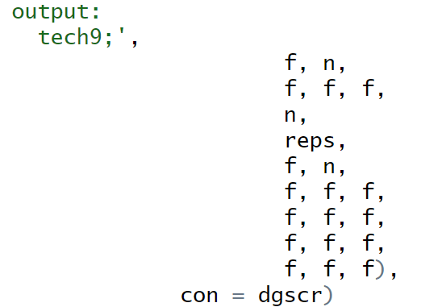
Data Generation Scripts
Write the data generation .inp scripts for each condition: writeLines() & sprintf()
writeLines “con” writes text to a .inp file
sprintf() returns character objects containing a formatted combination of input values
sprintf() allows us to refer to our objects and factors within the loops
Within sprintf(), “%s” refers to string (text), “%d” refers to digit (numeric)
the final line in sprintf() gives the order of the objects that are being referred to
…
…
Notes:
Model code not shown for brevity
# Using writeLines to write text lines to a .inp file
# sprintf() returns character objects containing a formatted combination of input values
# sprintf() allows us to refer to our objects and factors within the loops
# Within the sprintf function, %s refers to string value (text), %d refers to digit (numeric value)
# the final line in sprintf() gives the order of the objects that are being referred to

Slide 12
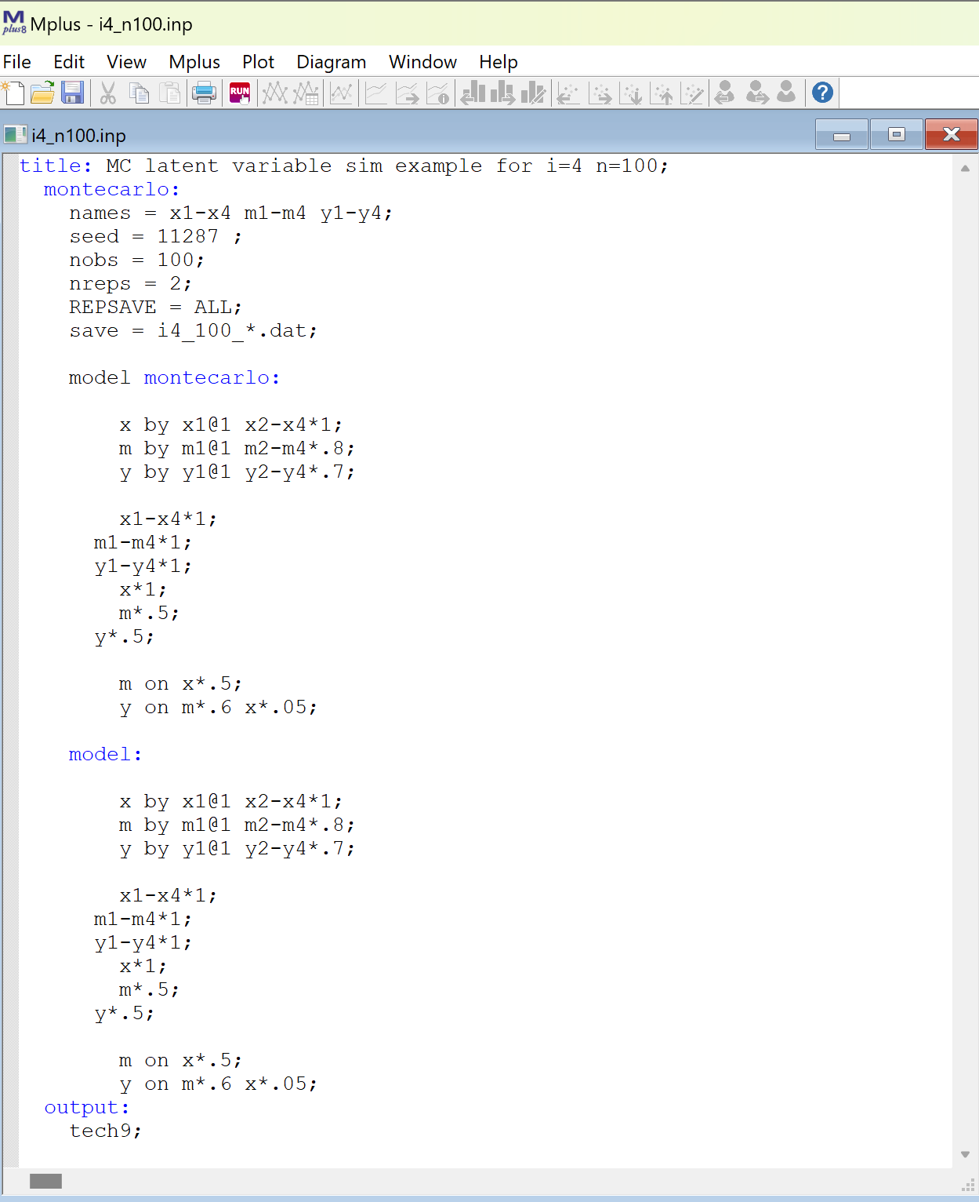
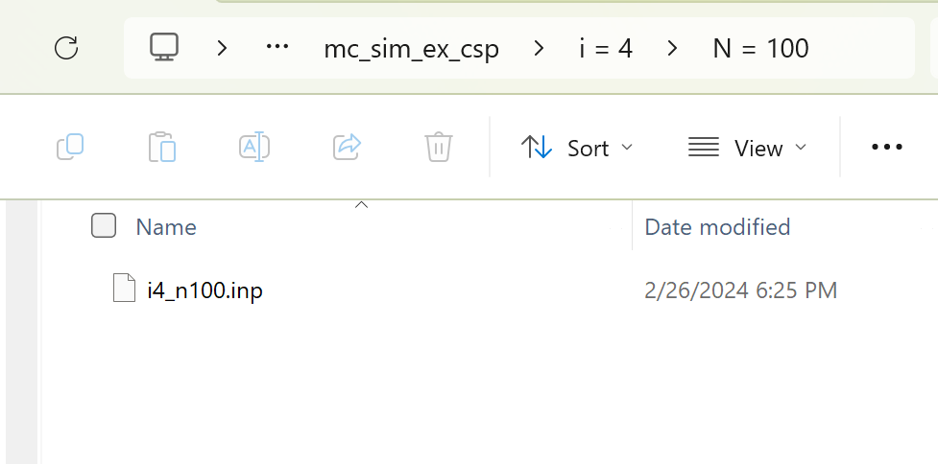
Sample Data Gen Script
Sub-directory now contains the single data generation .inp script for that condition

Slide 13
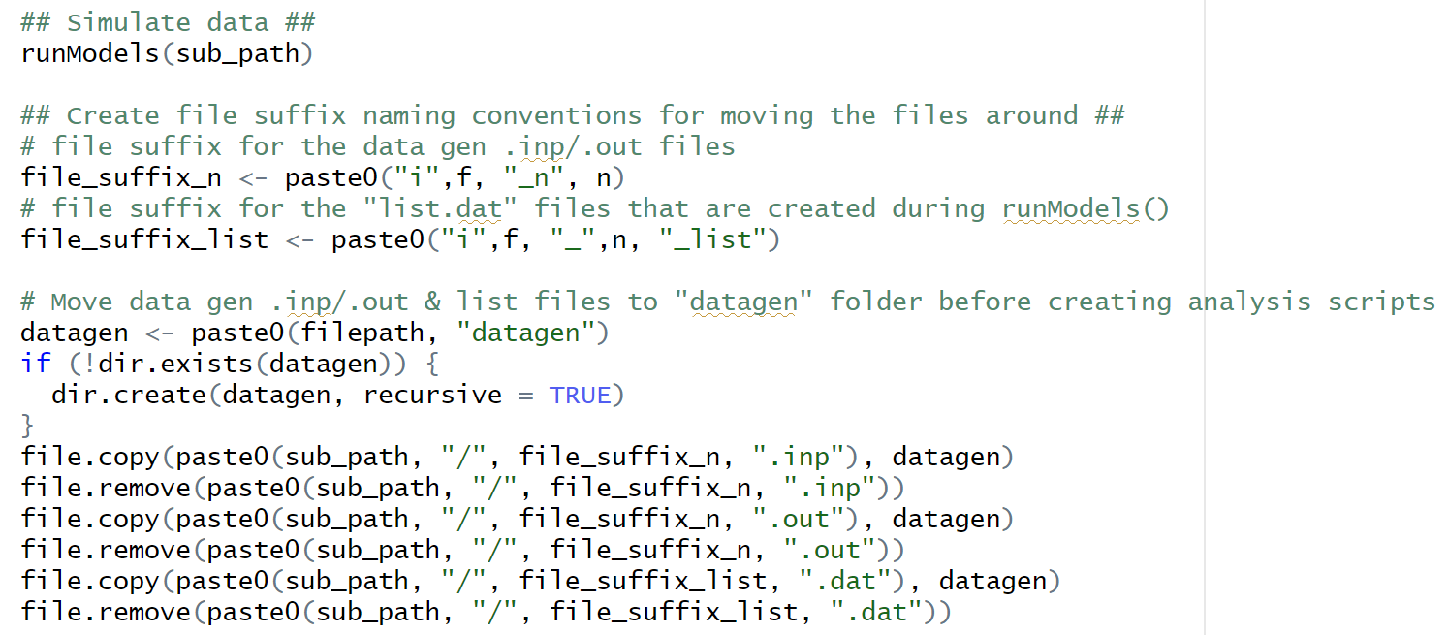
Simulate Data & Move Script Files
Simulate all data into condition folders: MplusAutomation runModels()
Move data gen scripts out of sub-directories to a new “datagen” folder: file.copy() & file.remove()
Make sure you have permission to write & edit your directories!

Slide 14
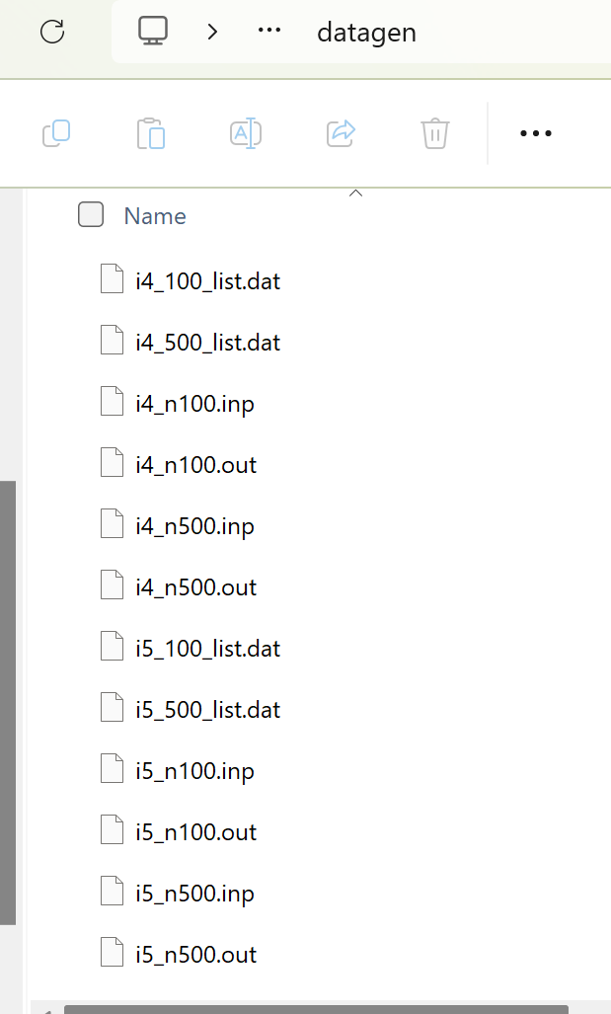
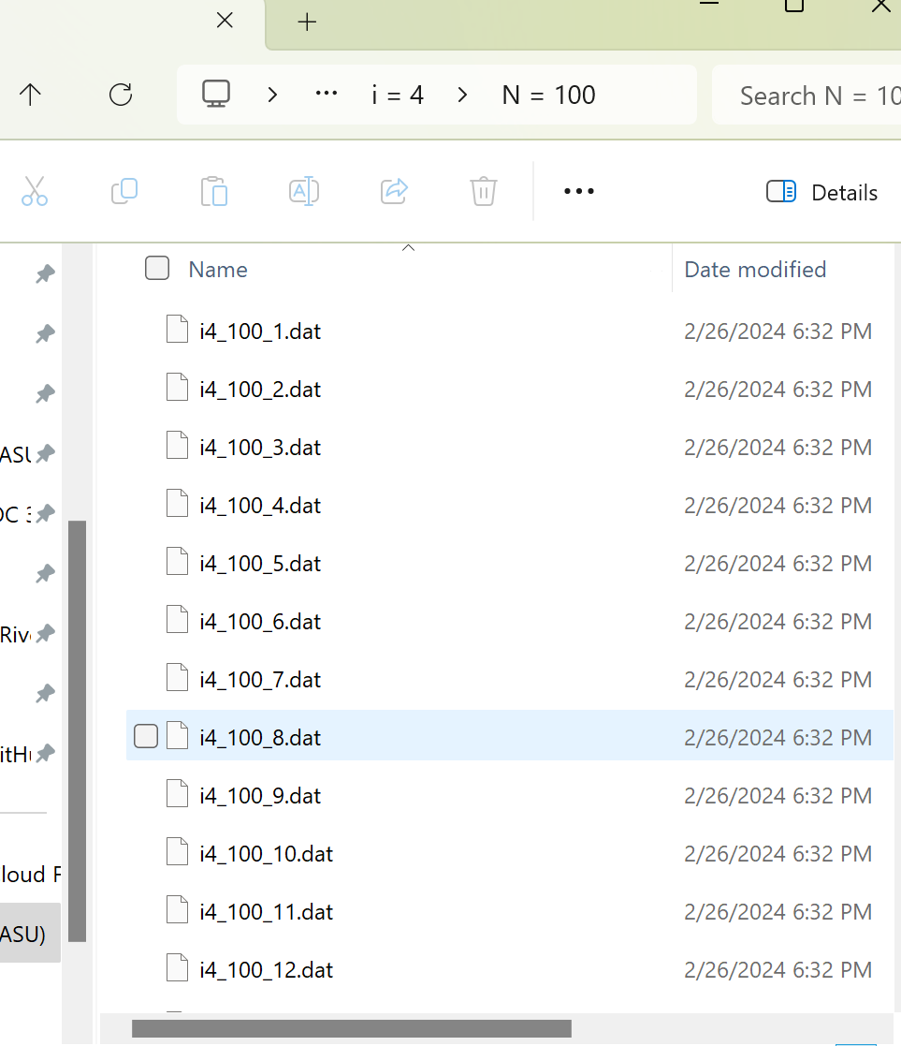
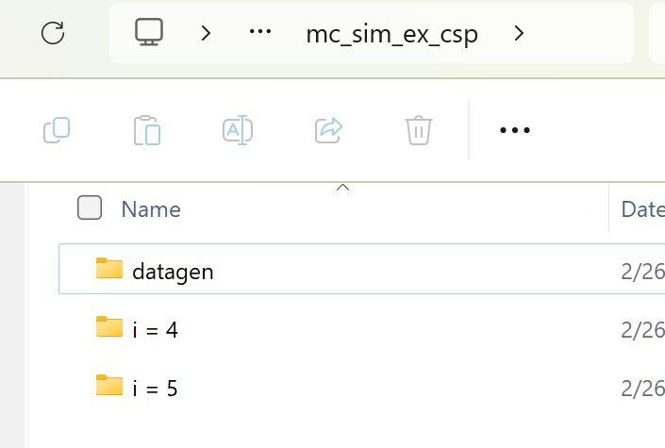
Updated Directories
Master directory now contains “datagen” folder with data gen .inp/.out & list.dat files
Sub-directories now contain simulated datasets
Notes:
Note: We move the files out of the sub-directories bc ultimately we will need just the replication .inp files in the subdirectories when we estimate the models

Slide 15
Creating Model Scripts & Model Estimation
Write & save creation scripts
Use creation scripts to generate analysis scripts for replications w/in conditions
Move creation scripts out of sub-directories
Run data analysis scripts for all replications in all conditions

Slide 16
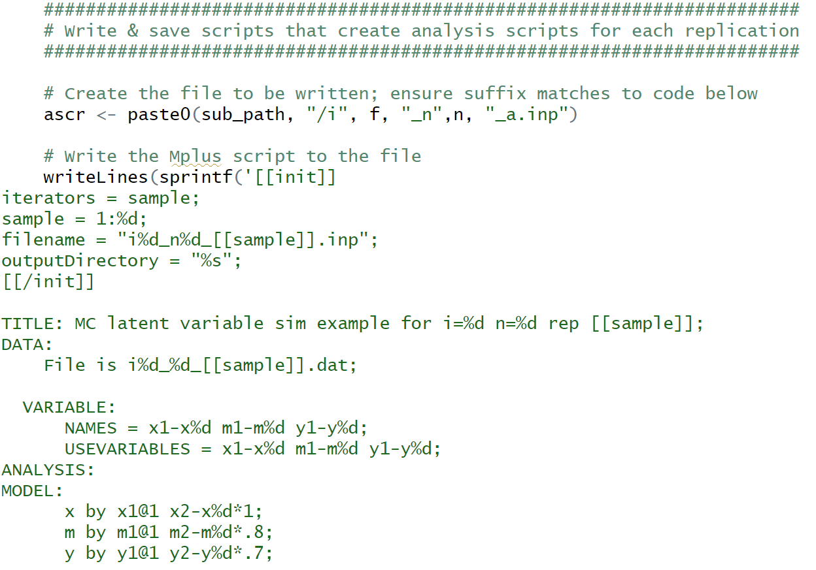
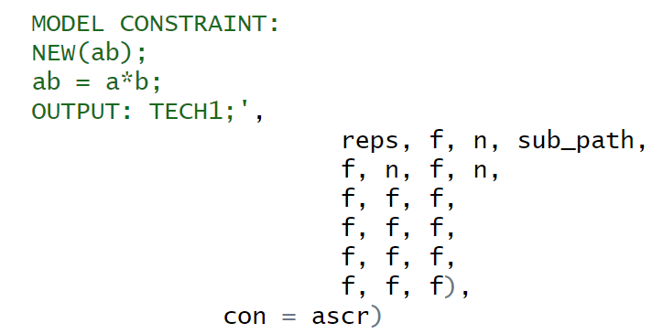
Creation Scripts
Write & save the .inp scripts that create the analysis scripts for each replication: writeLines() & sprintf()
[[init]] instructs MplusAutomation createModels() to loop over a variable called “sample” (reps)
This script contains the Mplus MODEL CONSTRAINT commands for calculating the indirect effect
…
Notes:
Write & save the .inp scripts that create the analysis scripts for each replication: writeLines() & sprintf()
This is done by condition & saved in condition sub-directories

Slide 17
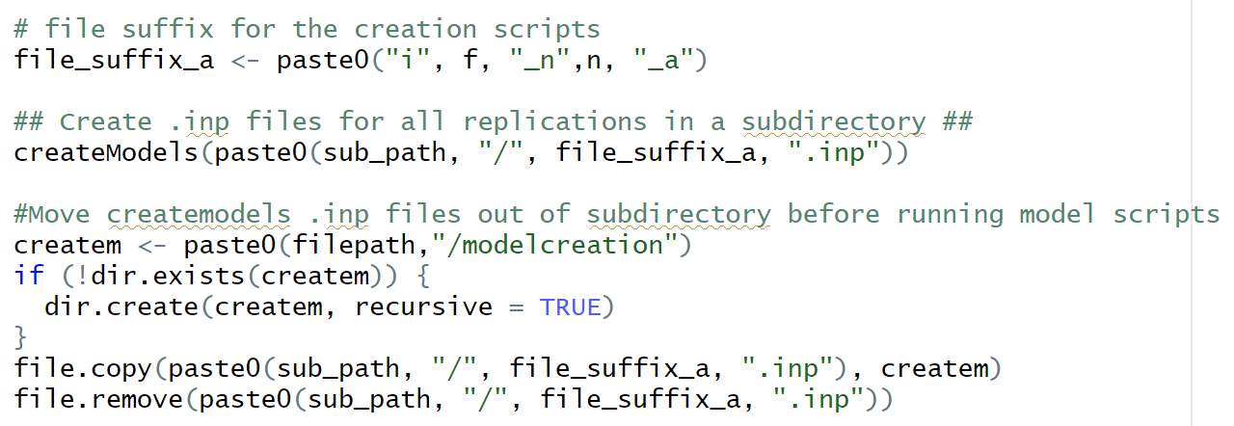
Create Model Scripts by Replication
Use the scripts we just created to generate model .inp scripts for each replication in each condition: MplusAutomation createModels()
Move creation scripts to their own folder (“modelcreation”): file.copy() & file.remove()
Make sure you have permission to write & edit your directories!

Slide 18
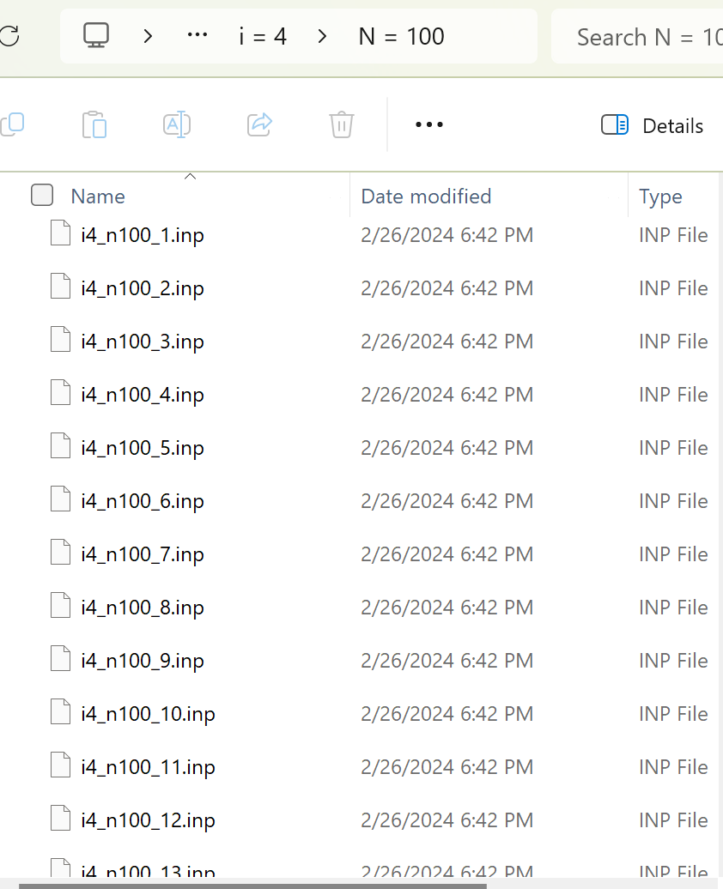
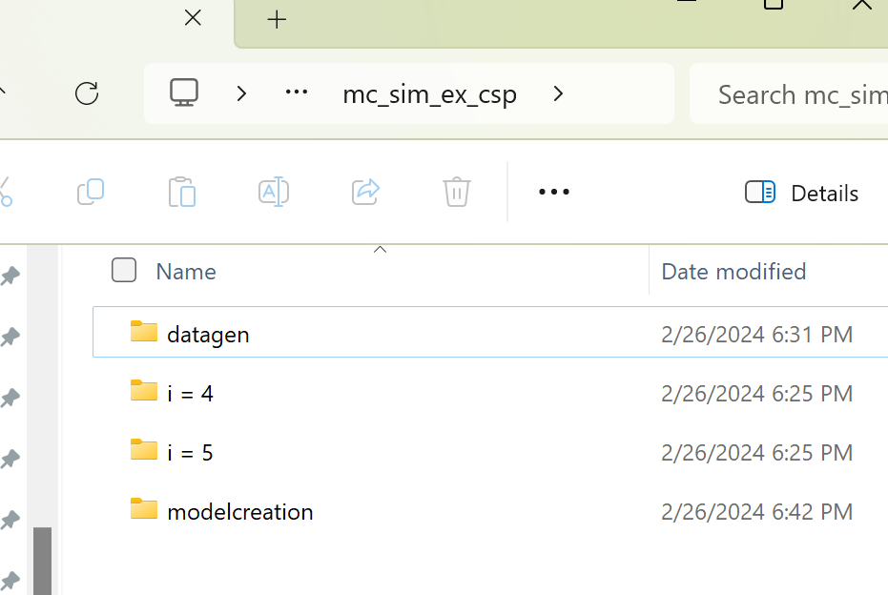
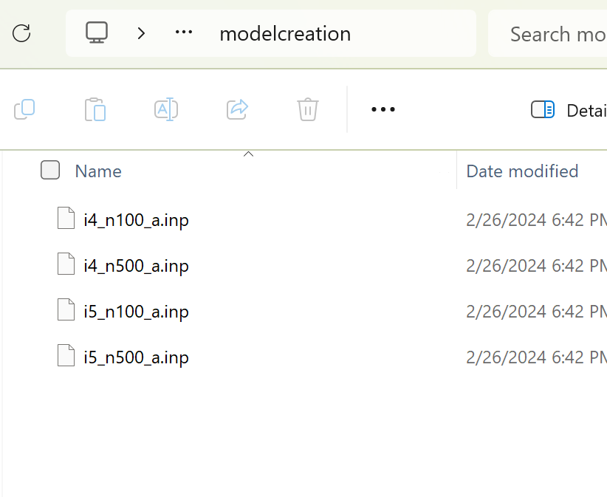
Updated Directories
Sub-directories now contain estimation scripts for each replication
“modelcreation” folder now contains the model creation scripts for each condition

Slide 19
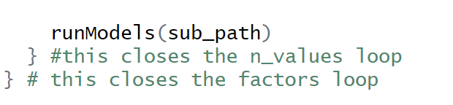
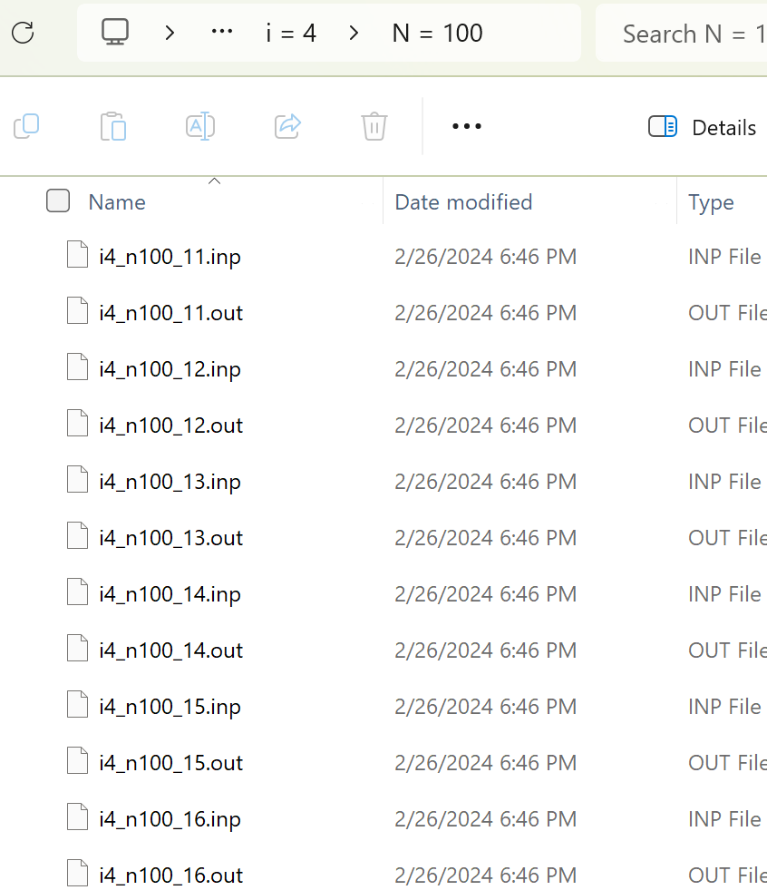
Run Models for All Replications
Run data analysis scripts for all replications in each condition: MplusAutomation runModels()
factors & n_values loops end here
Sub-directories now contain .out files for all corresponding .inp files
We are ready to read in estimates!

Slide 20
Saving Model Output by Condition
Output: parameter estimates, standard errors, p values
Read in replication-level list results from output files
Convert lists to datasets and create replication-level dataframe within each condition
Save condition-level dataframes as .dat files

Slide 21
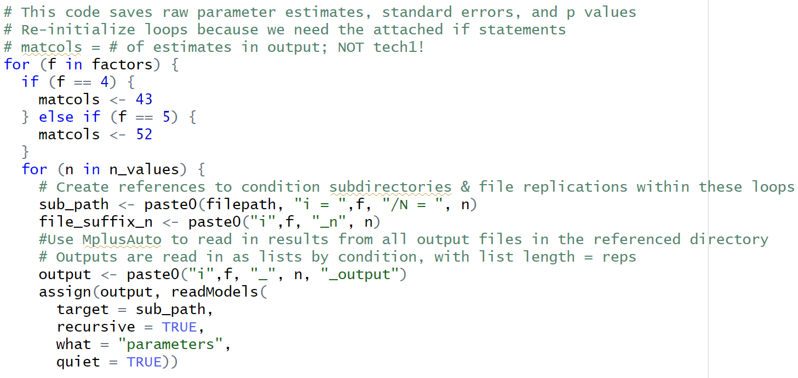


Read in Results Files by Condition
Read in all results from output files as lists of length = # of reps: MplusAutomation readModels()
Notes:
nb:
Recursive = TRUE means read in all files in any subdirectories. Necessary when you have multiple loops for the conditions
quiet = TRUE suppresses printing the file being processed, also shows status messages in the R console

Slide 22
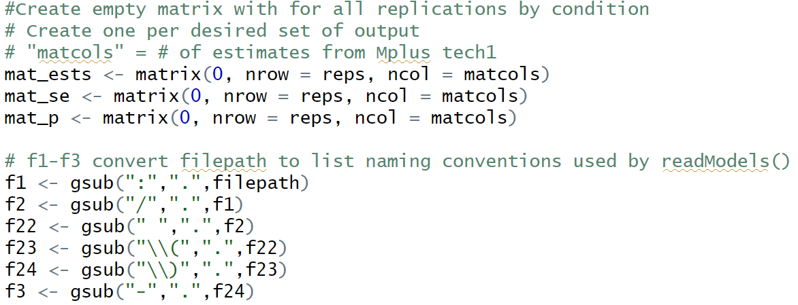
Interim Setup
Create empty matrices
Convert file paths to readModels directory naming conventions
“C:/Users/home/mc_sim_ex_csp/i = 4/N = 100/i4_n100_1.out“ → “C..Users.home.mc_sim_ex_csp.i...4.N...100.i4_n100_1.out“

Slide 23
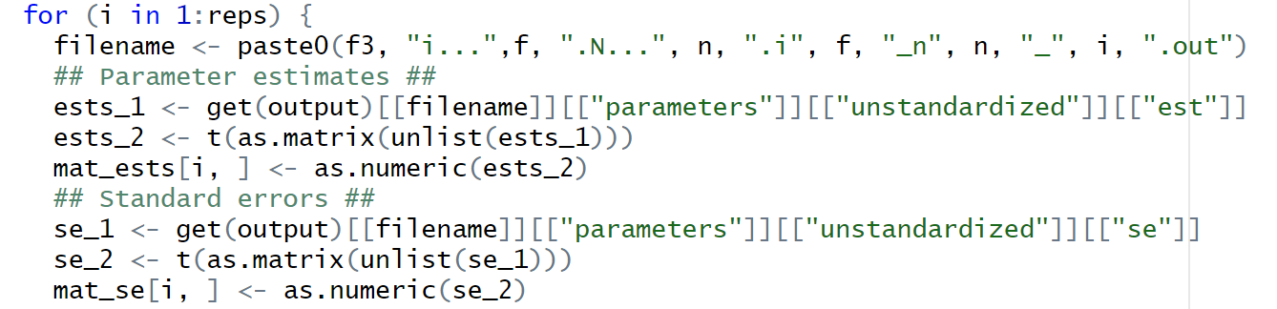
Converting Lists to Datasets
Convert lists to datasets for each replication and create replication-level dataframe within each condition: get(), unlist(), as.data.frame(), etc.
Pull column names
Replication loop ends after this code
Only shown for estimates & SEs, but you get the point!

Slide 24
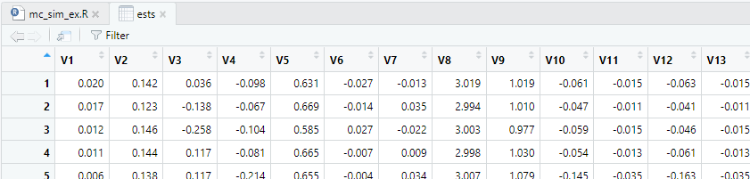
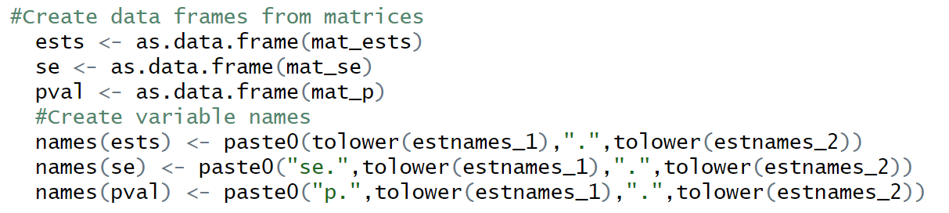
Save Condition-Level Datasets
Save dataframe as .dat file, 1 per condition
write.table() used to create condition-level .dat files that will be merged into one large replication-level dataset later
Condition loops end here
Notes:
nb:
Quote = FALSE means data are all numeric, no strings to read

Slide 25
Saving Model Output, Combining Conditions
Read in condition .dat files and stack them by rows into a single dataset
Restructure if necessary, assign variable names
Save all estimates from all reps and all conditions as .dat files (1 per output)

Slide 26
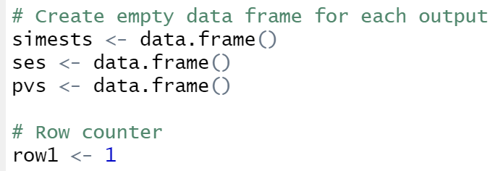
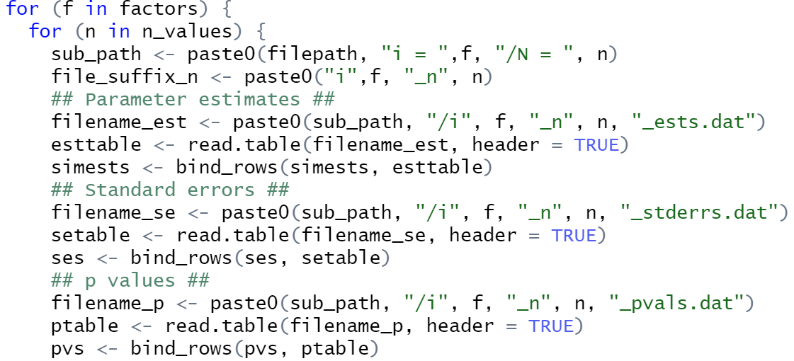
Reading in Condition Files
First, create empty dataset & row counter: data.frame()
Next, loop to read in condition-level .dat files & and stack them by rows into a single dataset: read.table(), dplyr bind_rows()

Slide 27
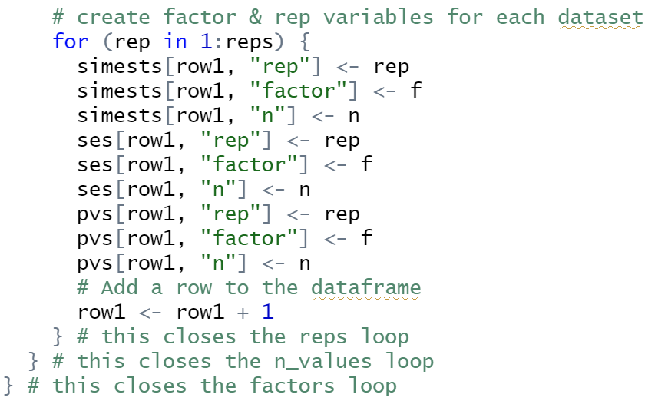
Add Replication & Condition Info to Datasets
All loops end here

Slide 28
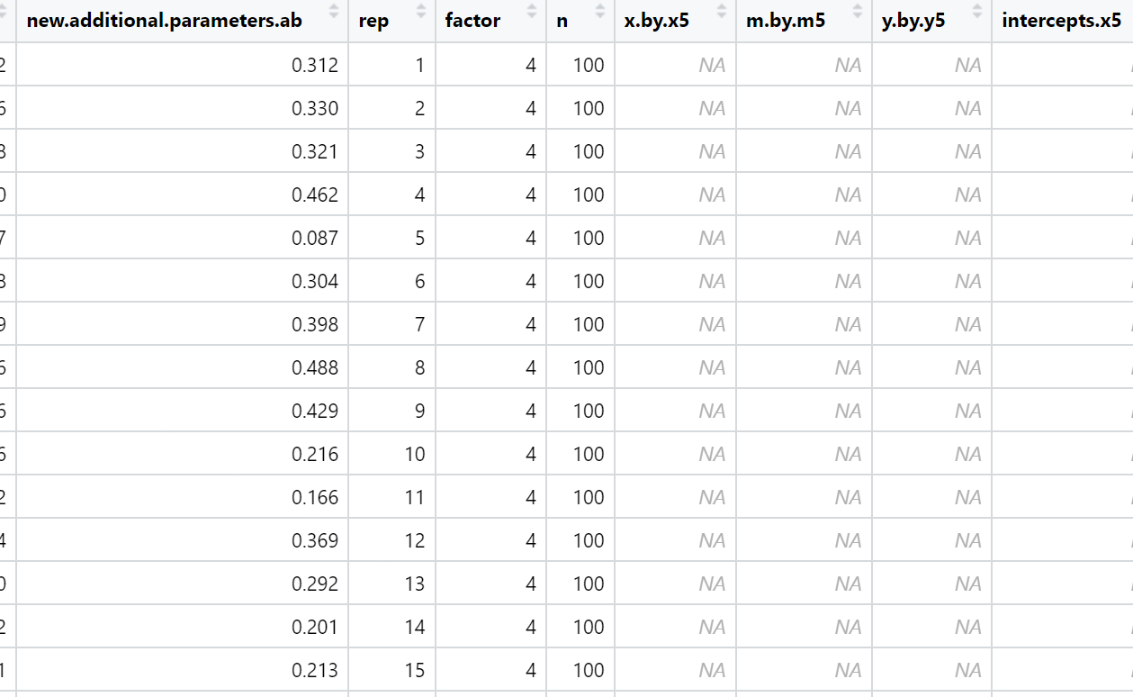
Saving Replication-Level Datasets
Save all estimates from all reps and all conditions as .dat file: write.table()
These datasets each contain 500 reps x 4 conditions = 2000 rows
Notes:
Nb: bottom screenshot is just a subsample of the estimates dataset

Slide 29
Increasing Efficiency
Computational intensiveness
HPC for faster computing

Slide 30
Considerations for Computational Intensiveness
Study design features
How many conditions?
How many reps?
How long does a single model take to run?
Model/analysis features that are computationally intensive
Latent classes
Multiple groups
Bootstrapped confidence intervals
Etc. – run a single model and see!

Slide 31
HPC for Faster Computing
With high performance computing (HPC) you can:
Compose jobs with 2 files, R script and very simple bash script
Significantly shorter time to conduct sim studies (hours vs. weeks)
HPC accounts typically come with home directory (ex. “/home/horourke/”) where you can save all sim files
File transfer via WinSCP or FileZilla (nb: this does take a while)

Slide 32
Mplus on HPC
Requires separate linux license
https://www.statmodel.com/pricing.shtml
Work with appropriate HPC admin to get Mplus module loaded onto your HPC of choice

Slide 33
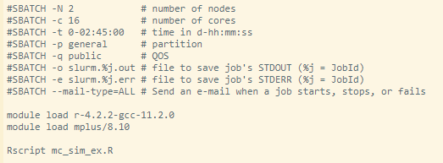
Sample Bash Script for MplusAutomation

Slide 34
Thank you!
Questions, critiques, and feedback for improvement (particularly increasing efficiency) are all very welcome:
horourke@asu.edu

